Slide 1


Natural Language Processing Tutorials
Become a natural language processing expert
Supervised by Dr. Kenny Zhu
TAs: Essam Abdelghany

Slide 2
Pop Quiz
Reminder in tutorials we recap on lecture via pop quiz, learn technologies discuss hard problems in assignments, demonstrate practical aspects of content learnt in lecture

Slide 3

Pop Quiz
1) Techniques used for NLP and Speech Processing Include………..
a) Feedforward Neural Networks
b) RNNs, LSTMs &GRUs
c) CNNs
d) Transformers
e) All of the above
Take notes as quizzes may not be posted in solved form.

Slide 4
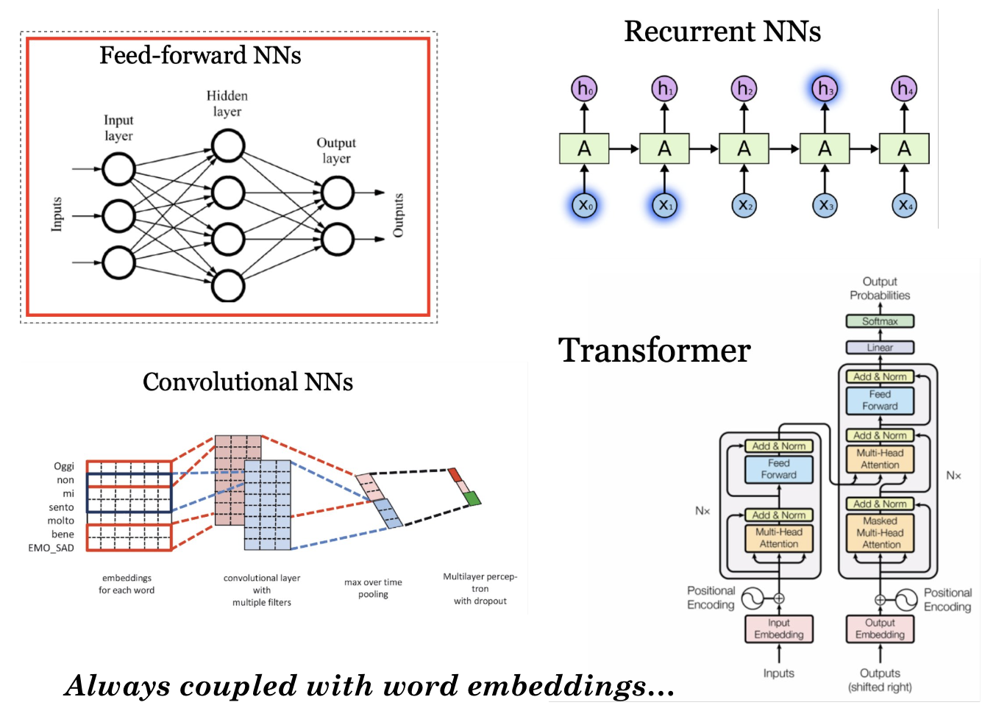
Pop Quiz

Slide 5
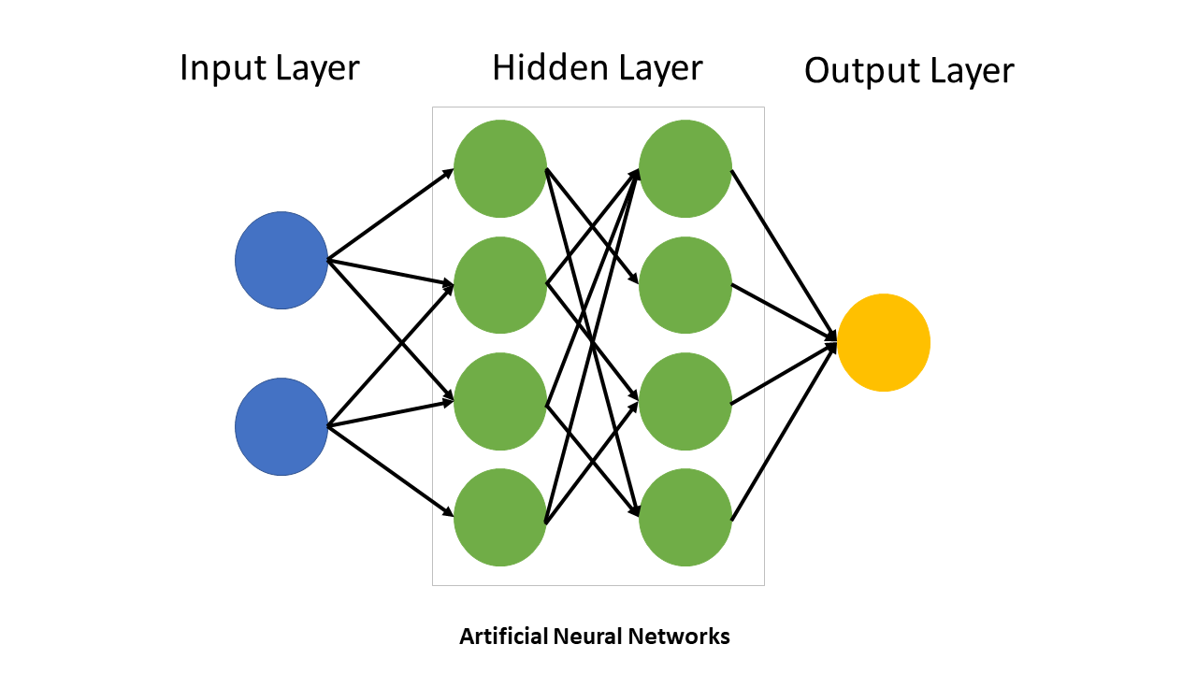
Pop Quiz
2) Among the parameters to tune in a neural network………..
a) The number of hidden layers
b) The number of neurons per hidden layer
c) The activation function per layer
d) Optimizer hyperparameters
e) All of the above
Take notes as quizzes may not be posted in solved form.

Slide 6
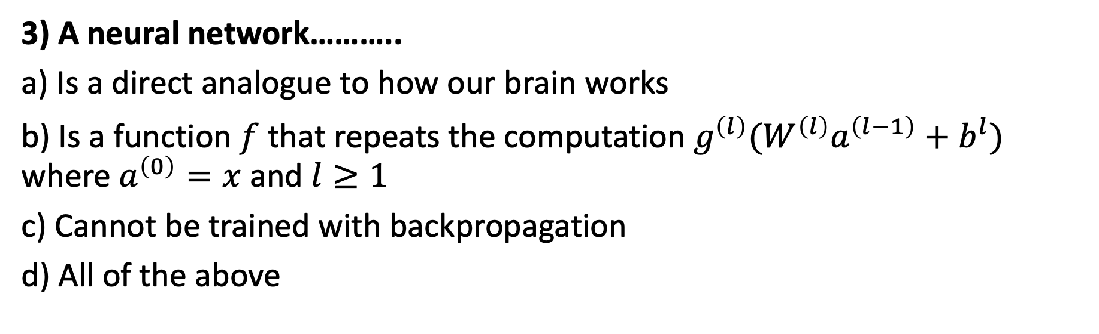
Pop Quiz
3) A neural network………..
a) Is a direct analogue to how our brain works
b) Is a function $f$that repeats the computation $g^{\left(l\right)}(W^{\left(l\right)}a^{\left(l−1\right)}+b^{l})$ where $a^{\left(0\right)}=x$ and $l≥1$
c) Cannot be trained with backpropagation
d) All of the above
Take notes as quizzes may not be posted in solved form.

Slide 7
Pop Quiz
4) Cosnider a NN with 10,20,2 neurons per layer an input size of 5
a) Such network has (2*20+2) + (20*10+20) + (10*5+10) parameters
b) Such network has (10*20*2+1*2*1) parameters
c) We will need to update the gradient for all the parameters
d) Four activation functions will need to be decided
Take notes as quizzes may not be posted in solved form.

Slide 8
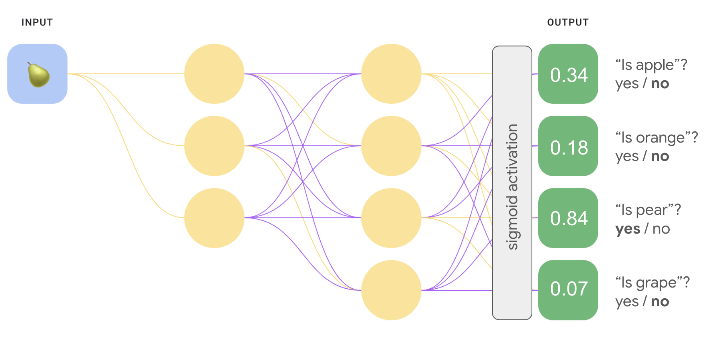
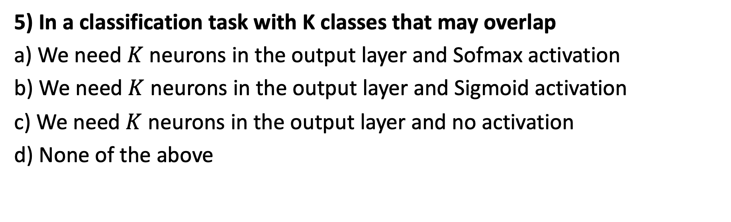
Pop Quiz
5) In a classification task with K classes that may overlap
a) We need $K$ neurons in the output layer and Sofmax activation
b) We need $K$ neurons in the output layer and Sigmoid activation
c) We need $K$ neurons in the output layer and no activation
d) None of the above
Take notes as quizzes may not be posted in solved form.

Slide 9
Thank You

